Slide 1
TINICUM · FDE SUPER-DAY CASE
Beacon Fasteners
A confirmation desk for Lisa, and a vendor readout for the plant manager
Task 1
Confirmation Desk: vendor PDFs checked against open POs, worst-first to-do list in Excel
Task 2
Vendor readout: 8 months of ERP history, received value, vendor comparison, who to call first
Next
Vendor forms: Beacon's own acknowledgment form and supplier pack, pre-filled from the ERP
Smrita Pandey · "Useful beats impressive."
Notes:
30 minutes: ~12 on Task 1, ~10 on Task 2, ~8 on limits, questions and data I wish I had. Everything shown runs from one command on the case data; every number came out of the tools, not typed in.

Slide 2
EXECUTIVE SUMMARY
Two tools: exceptions for Lisa, evidence for the plant manager
LISA · TASK 1
PLANT MANAGER · TASK 2
Confirmation Desk
Vendor performance readout
35
22/44
2
$28.2M
42%
61/63
vendor PDFs read (4 scans by OCR, 4 German)
open PO lines clean: no action needed
items to act on today
received Sep 2025 to May 2026 (after cleaning)
Continental on time; other vendors 69-99%
of the lines >7 days late are Continental's
Silently dropped line: Apex left PO-4500050001 line 2 (1,500 pcs) off its acknowledgment.
Stray PO: a confirmation arrived for PO-4500060619, which is not an open Beacon PO.
Remembers: handled items stay handled, the first promise date is never overwritten.
Fixes it at the source: Beacon's own acknowledgment form and supplier pack, pre-filled from the ERP.
Call first: Continental Quality Heat Treat. Late most often and by the most, and not improving. Part of it is our 19-day planned lead time vs their 28-day quote.
Call second: Apex, commercially. 85% of spend; CRES bar confirmed 1-2% over PO since Feb; $77k of short-shipped balances left open.
Beacon Fasteners · FDE case 2
Notes:
If you remember one thing per task: Task 1 turns 35 PDFs into 23 things to do, worst first, and 22 lines Lisa never has to look at. Task 2 says call Continental first, with the numbers behind it, and says honestly that part of the problem is our own planning lead time.

Slide 3
PROBLEM FRAMING
Two users, two decisions, and what a miss costs each
 | Lisa, senior buyer | Plant manager
Decision | Is every line I ordered confirmed at my qty, price and date? If not, who do I chase today? | Which vendor deserves my attention first, and what do I say to them?
Today | ~90 min/day reading ~35 PDFs (clean ERP output, scans, German, vendor part numbers) against ~50 open POs | 8 months of ERP history nobody has analysed; vendor decisions run on anecdote
Hardest part | Noticing what is NOT on the page: a silently dropped line | The ERP data looks clean but isn't (8 traps, next section)
Cost of a miss | Receiving shorts, AP price disputes, customer expedites | The wrong vendor gets the call; the real cause (sometimes ours) stays hidden
What I built | A daily check that produces a worst-first exception list in Excel, with memory | A one-page readout plus a workbook with every definition, numerator and denominator
Design test for both: could the user act on it tomorrow morning without me in the room?
Beacon Fasteners · FDE case 3

Slide 4
TASK 1 · PRODUCT DECISION
An exception list Lisa opens in Excel, not a dashboard to learn
1
Excel workbook is the product
Rules it never breaks
Action List first, worst first: what happened and what to do, in words. Lisa types Yes in Done? and adds Notes; the next run reads them back.
Never guesses silently. Anything not matched on an identifier goes to Review Required.
Says "possible dropped line", not "dropped": the vendor may confirm it separately.
Never sends anything. Vendor emails are drafts; Lisa owns the relationship.
Every PDF gets a status and every open PO line is accounted for (checked on each run).
2
Same engine as a small browser app
Drag in the day's PDFs; approve a new vendor part number in one click; see each scan next to what was read from it. Optional.
3
Memory in one local file
Duplicate PDFs are ignored, corrected acknowledgments close items on their own, the first promise date is kept.
4
Deterministic first
6 stable vendor layouts, so one small parser each. The AI reader is only a fallback for unknown layouts and is off by default.
Beacon Fasteners · FDE case 4
Notes:
Why Excel: Lisa already works from a PO list in Excel and Outlook. A new tool that needs a login and training won't get used. The app exists for the two things Excel is bad at: dragging PDFs in and one-click approval of part numbers. Both read and write the same memory file, so they always agree.

Slide 5
TASK 1 · HOW IT WORKS
Five deterministic steps from vendor PDF to Excel
Read
Normalize
Match
Check
Report
Text layer: 31 PDFs
OCR: 4 Continental scans
AI fallback: off
Dates, units, decimals
German labels, "KW 20-22"
EUR→USD at ERP rate
Vendor, PO, then each line via the 5-level ladder below
Missing line · qty
price · date vs need
date sanity · revisions
Excel workbook + memory (SQLite)
8 sheets
Part-number matching ladder: identifiers first, inference only with review
Level | Evidence | Confidence | What happens
L1 | Beacon part number printed on the vendor's document | HIGH | Auto-match
L2 | Approved (vendor, vendor PN) entry in the crosswalk | HIGH | Auto-match; the crosswalk grows every time Lisa approves
L3 | Normalized description equals the PO description | HIGH | Auto-match
L4 | Only qty + price (+ line number) agree on this PO | MEDIUM | Matched for the checks, but sent to Review Required
L5 | Nothing agrees | UNMATCHED | Shown as unmatched; never guessed
Beacon Fasteners · FDE case 5
Notes:
Tolerances were chosen from the data, not invented. USD prices: any change is flagged, because ERP prices are exact to 4 decimals. EUR prices: flagged over 1%, because month-to-month FX noise in the ERP rates is about 0.3%. On this data every L4 inference was an exact qty and price match, but it still goes to review because two lines could share both.

Slide 6
TASK 1 · RUN ON THIS WEEK'S 35 PDFS (AS OF 05/17/2026)
23 things to do, worst first, and 22 lines Lisa can skip
When | Vendor | PO / line | What happened | What to do
Today | Apex | 4500050001 / 2 | Line missing from acknowledgment (BAR-A286-250 × 1,500) | Ask if it ships, or receiving will be short
Today | Apex | 4500060619 | Confirmation for a PO that is not open (probably meant for …0001) | Tell vendor not to ship against it
This week | Apex | 4500050007 / 1 | Confirmed 1,425 of 1,500 (-75 pcs) | Balance later, or cancelled?
This week | Apex | 4500050002 / 1 | Price $3.9200 → $4.0102 (+2.3%) | Push back before the invoice reaches AP
This week | Continental | 4500050022 / 1 | Promise 21 days after we need it | Expedite, or warn planning
This week | Liberty | 4500050019 / 1 | Acknowledged with no qty or date | Ask for a firm qty and date
This week | Ostmark (DE) | 4500050027 / 1-2 | Promise is a week range "KW 20-22", 16 days late | Pin down a real date
Check | Heritage, Ostmark | 3 lines | New vendor PNs APH-441-OS, OST-CAR-A-100 | One-click approve (Review Required)
Check | QuickShip | 4500050032 | Sent an invoice instead of an acknowledgment | Tell receiving; hold the invoice
2 · 8 · 13
act today · this week · check
22
lines fully clean: never shown on the Action List
11
items on Review Required (incl. OCR'd scans)
Built-in checks, every run:
✓ every PDF has a status
✓ every open PO line accounted for
✓ revision superseded original (QuickShip)
Beacon Fasteners · FDE case 6
Notes:
The dropped line is the headline: it's the thing Lisa said matters most and the hardest to see, because it's an absence. The tool knows it's missing because it starts from the open PO list, not from the PDF. The stray PO shows the same idea in reverse. 13 'check' items are mostly date sanity: acknowledgments dated before the PO, or Continental promise dates before the confirmation date.

Slide 7
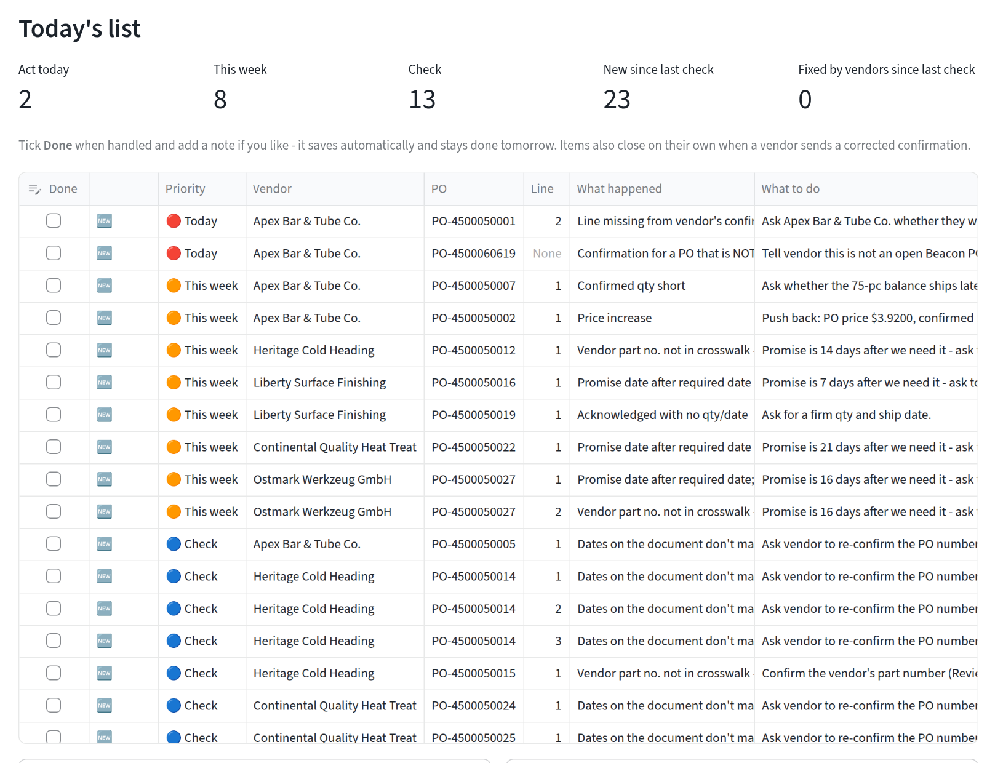
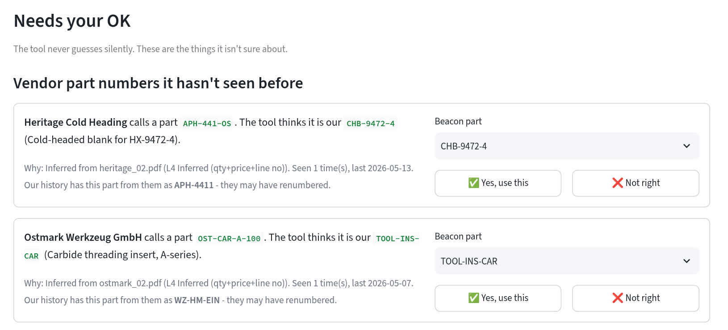
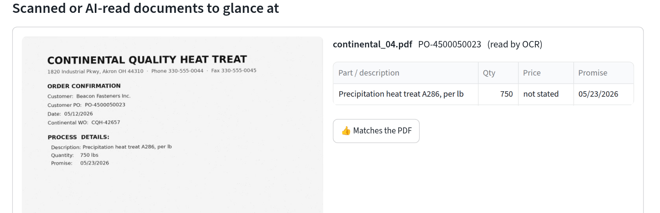
TASK 1 · WHAT LISA SEES
Today's list, plus the things the tool is not sure about
Needs your OK: the vendor renamed a part. The tool shows why it thinks so and what our history calls it. One click approves it for good.
Scans are shown next to what OCR read, so checking takes seconds, not retyping.
Beacon Fasteners · FDE case 7
Notes:
Live demo here if time allows: open the app, click 'Load this week's sample confirmations', tick one Done, approve one part number, then Download Excel and show the same state in the workbook.

Slide 8
TASK 1 · THE PAST AND FUTURE PROBLEM
A desk that remembers: tomorrow's list shows only what's new
Situation | What the tool does
Same PDF emailed twice | Recognised by its content hash and ignored
Lisa marks an item Done | Stays done tomorrow, with her note
Vendor sends a corrected acknowledgment | The open item closes by itself, with the reason
A new problem appears on a line she had closed | Reopens it and says why
Vendor keeps moving the promise date | The FIRST promise is never overwritten, so the history stays honest
Lisa approves a vendor part number once | Matches automatically from then on and joins the part-number crosswalk
Why keep the first promise
If every revised date overwrites the last one, every PO ends up looking on time and vendor performance can't be measured. The same trap is in the ERP: 30 confirmations were superseded.
Tested
58 automated tests. TestDayTwo runs day 1 on the real PDFs, applies Lisa's Excel edits, then feeds a revised vendor PDF on day 2 and checks each row above.
Beacon Fasteners · FDE case 8
Notes:
This is the answer to 'is it a one-time script?'. The store is one SQLite file: items, notes, append-only promise history, crosswalk approvals and file hashes. The Excel and the app read and write the same store.

Slide 9
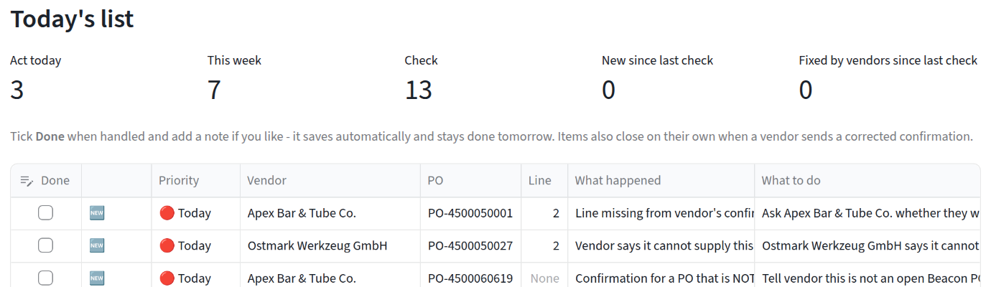
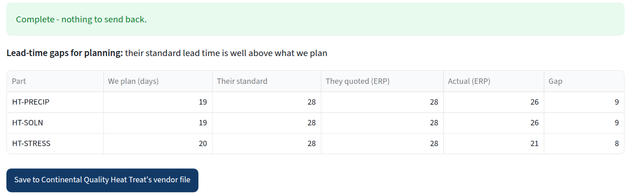
TASK 1 · PAST FEEDS FUTURE
Fix it at the source: Beacon's own forms, pre-filled from the ERP
PO acknowledgment form
Ostmark answers on the form: line 2 is now "Vendor declined" (act today, with the reason), not a guess
One Excel file per PO, sent with it
Our lines locked; rows can't be deleted, so nothing drops silently
Every line: Accept / Accept with changes / Cannot supply
One real delivery date; Excel refuses "KW 20-22"
Reason code for any qty or price change
Returned file drops into the same check: HIGH match, no OCR
Continental returns its pack: MRP plans 19 days, their standard is 28
Supplier information pack
Once per vendor, pre-filled from 8 months of ERP
Every part we buy from them, with planned / quoted / actual lead time
They confirm their part numbers → Lisa's approval queue
Standard lead times → gap report for planning
Contacts, turnaround, AS9100 / Nadcap expiry
Vendor replies in the demo are synthetic. Plain Excel: no portal, no logins; PDFs keep working for everyone else.
Beacon Fasteners · FDE case 9
Notes:
This is the answer to past vs future. The past: the ERP tells us every part each vendor supplies, what we paid, and the real lead times; it pre-fills both forms and gives Lisa a list of $128k of old open balances to chase or short-close. The future: the vendor answers in our format, so the three hardest problems (dropped lines, week-range dates, vendor part numbers) are prevented rather than detected. Roll out to the three vendors that cost the most reading time first: Continental's scans, Ostmark's German week ranges, Heritage's part numbers.

Slide 10
TASK 2 · DATA BEFORE METRICS
The ERP extract looks clean but isn't: 8 traps found first
Receipt dates are MM/DD/YYYY text: SQLite date() returns NULL on every row.
50 reversal pairs (keyed in error, then reversed) plus 1 unreversed duplicate (txn 701546).
po_line.qty_received is wrong on 169 lines; receipts are used instead.
30 superseded confirmations: only the latest is used.
Confirmation feed stops 2026-04-03: promise metrics use POs to 03/30 only.
Ostmark PO prices are already USD: converting again adds about $76k.
qc_hold dates are unreliable (16 before the PO existed): shown as counts only.
5 decoy tables with no link to vendor performance (GL, MRP, users, …).
The naive answers are wrong by +$1.3M and -$2.9M. Every number in the readout says which records it counts (Definitions tab).
Beacon Fasteners · FDE case 10
Notes:
Each trap was verified independently. The date format one is sneaky: a SQL-only analysis silently returns nothing by month. Received value = net receipt qty times PO unit price. Receipts carry no price, so this is value at PO price, not invoiced cost; I say that on the readout.

Slide 11
TASK 2 · RECEIVED VALUE BY MONTH
$28.2M received in 8 months, 85% of it from Apex
$28.19M
received value, 09/06/2025 to 05/17/2026
85%
Apex Bar & Tube ($23.98M): a concentration question, not only a performance one
$3.1-5.1M
range across full months (Oct to Apr); no clear trend
* Sep and May are partial months. Reversals netted, 1 duplicate excluded.
Beacon Fasteners · FDE case 11

Slide 12
TASK 2 · VENDOR-BY-VENDOR
Continental stands out on delivery; Apex on dollars
Vendor | Received | Share | On time | Lines >7d late | Median days late (when late) | Promised after need | Past-due open $ | On time Sep-Dec → Jan-May
Apex Bar & Tube | $23.98M | 85.1% | 87% | 0 | 1 | 19% | $76.7k | 87% → 87%
Heritage Cold Heading | $1.71M | 6.1% | 72% | 2 | 3 | 60% | $4.1k | 70% → 74%
Continental Quality Heat Treat | $1.51M | 5.4% | 42% | 61 | 17 | 91% | $14.0k | 45% → 40%
Ostmark Werkzeug (DE) | $0.87M | 3.1% | 69% | 0 | 2 | 20% | $31.9k | 71% → 68%
Liberty Surface Finishing | $0.11M | 0.4% | 91% | 0 | 1 | 20% | $1.1k | 95% → 87%
QuickShip Industrial | $0.01M | 0.05% | 99% | 0 | 1 | 16% | $0.04k | 98% → 100%
On time = the last receipt that completes the line arrives on or before our required date. Denominators: due lines with a receipt (Apex 222, Heritage 205, Continental 134, Ostmark 55, Liberty 189, QuickShip 110). Trend = Fisher exact test; no vendor's change is statistically significant (Liberty p=0.13). Not ranked: QC holds (dates unreliable). No composite score: the weights would be invented.
Beacon Fasteners · FDE case 12
Notes:
I deliberately did not build a 0-100 vendor score. Any weighting of lateness vs price vs shortage would be my opinion dressed up as math. Instead, the table shows absolute and relative numbers side by side, with the denominators.

Slide 13
TASK 2 · WHO TO CALL FIRST
Call Continental first: late most often and by the most
42%
61/63
91%
of 134 due lines on time (others 69-99%)
lines >7 days late across all vendors are theirs ($660k)
of their confirmations promise after our need date
How bad: median 17 days late when late, worst 28. Every other vendor lands 99%+ of lines within 7 days.
Not a recent slip: 45% on time Sep-Dec (n=56) vs 40% Jan-May (n=78).
Misses its own dates: meets only 58% of its own promises.
Material: $1.51M of heat treat; 7 open lines past due today ($14k).
Beacon's side too: we plan 19 days for heat treat, they quote 28 and deliver in 24.5 (medians). Part of this lateness is our planning. Take that to the call.
Beacon Fasteners · FDE case 13
Notes:
Questions for the call: can you commit to a standard lead time we can load into MRP? When you confirm a date you meet it 58% of the time; what drives the misses: furnace capacity, batching, or late incoming parts from us? 51% of lines arrive split; can partial lots be avoided or flagged? Language is deliberate: highest observed delivery exposure, not 'caused production delays'. The ERP has no production-impact data.

Slide 14
TASK 2 · SECOND CALL AND WATCH LIST
Call Apex second, about money not delivery; watch three others
Apex Bar & Tube: a commercial call
Heritage Cold Heading
72% on time; 60% of promises after need date. Delays short (median 3 days). 10 short-ship balances open.
85% of received value ($23.98M). 87% on time, and when late the median is 1 day.
Price creep: BAR-CRES-250 confirmed +1% from February and +2% from March, while every PO stayed at $3.92. 11 lines, $8.5k over PO, and nothing in the ERP flags it.
Short-ships left open: 8 balances, $77k, the largest past-due exposure of any vendor (oldest 215 days).
Same pattern this week: a dropped line, a 75-pc short and a +2.3% price on its acknowledgments.
Liberty Surface Finishing
95% → 87% on time, but not significant (p=0.13) and misses are 1-3 days. Watch, don't call.
Ostmark Werkzeug (DE)
69% on time, never >6 days late. Open die set PO-4500050027: $31k, due 05/15, nothing received; ack says only "KW 20-22".
QuickShip Industrial
The benchmark: 99% on time, but only $13k of spend.
Beacon Fasteners · FDE case 14
Notes:
Why Apex isn't first: its delivery is fine. The issue is commercial and cumulative, and the right person is probably Lisa plus whoever owns the supply agreement. The price creep may be a legitimate alloy surcharge that never made it into the PO price; that's a question, not an accusation.

Slide 15
TASK 2 · TOWARD THE PART-NUMBER CLEANUP
The crosswalk grows from daily work and seeds the part master
Vendor | Vendor PN | Beacon PN | Source | Status
Heritage | APH-441-OS | CHB-9472-4 | This week's PDF (qty+price) | PENDING: ERP had APH-4411
Ostmark | OST-CAR-A-100 | TOOL-INS-CAR | This week's PDF (qty+price) | PENDING: ERP had WZ-HM-EIN
Heritage | APH-125 / 318 / 441 / 4411 | CHB-3301 / 7715 / 9472-3 / 9472-4 | ERP confirmations × PO lines | Seen 30-44 times each
Heritage | K-1050 | CHB-5520 | ERP confirmations × PO lines | Seen 41 times
Ostmark | K-1050 | TOOL-PUNCH-STD | ERP confirmations × PO lines | Same PN, different part!
Ostmark | WZ-9472-DS / WZ-HM-EIN | TOOL-DIE-9472 / TOOL-INS-CAR | ERP confirmations × PO lines | Seen 17-20 times each
For the cleanup
Key on (vendor, vendor PN), never the PN alone: K-1050 means two different parts.
Vendors renumber quietly: 2 renumberings caught this week.
Each row keeps source, confidence, first/last seen and review status.
Path: Lisa approves in the desk → crosswalk file → import as the part-master seed.
Mined from the ERP: 8 mappings. Task 1 adds new ones as Lisa approves them (output/pn_crosswalk_updated.csv).
Beacon Fasteners · FDE case 15

Slide 16
SCOPE
What I deliberately did not build, and why
✕
ERP integration or write-back
✕
Auto-emailing vendors
✕
LLM-first extraction
No API access, and a wrong write is expensive. The CSV export is the contract; integration comes after trust.
The tool drafts emails; Lisa sends them. Vendor relationships are hers.
6 stable layouts parse deterministically and auditably. The AI reader is a fallback, off by default.
✕
Full master-data (MDM) platform
✕
A 0-100 vendor score
✕
A vendor portal or EDI (yet)
The crosswalk file, with source, confidence and review status, is the seed. The platform comes later.
The weights would be invented. An evidence table with denominators is more honest.
Vendors live in email and Excel. The form fields map 1:1 to a portal or EDI 855 later; no hosting or logins now.
Beacon Fasteners · FDE case 16

Slide 17
LIMITS
Where this falls over, and what catches it when it does
Failure mode | What happens today | Mitigation / next step
A new vendor or a changed layout | No parser matches; the PDF shows as unreadable | Beacon's acknowledgment form removes the layout problem; meanwhile manual form or AI reader (off by default)
Vendors don't use the form | They keep sending their own PDFs | PDFs keep working; start with the 3 vendors that cost the most reading time
A poor scan | OCR can misread a digit | Every OCR'd doc goes to Needs your OK, shown next to the image
Two PO lines with the same qty and price | An L4 inference could pair the wrong lines | L4 is never HIGH; always goes to review
A stale open-PO CSV | False "PO not open" or "possible dropped line" | Pull the export each morning; show its as-of date
FX and price tolerance | EUR checked at the ERP monthly rate, 1% band | Confirm with Lisa and AP what counts as a real difference
Task 2: value at PO price | Not invoiced cost; no AP data in the extract | Add invoice lines, then true price variance
Task 2: the confirmation feed ends 04/03 | Promise metrics use POs to 03/30 only | Ask why the feed stopped
Task 2: no production-impact data | Can rank exposure, but can't prove cost | Link to expedites and downtime; no causal claims until then
Beacon Fasteners · FDE case 17

Slide 18
WHAT I WISH I'D ASKED
Questions for Lisa and the plant manager, each tied to the data
LISA
PLANT MANAGER
When a line is missing from an acknowledgment, what do you do today, and how often was it really dropped vs. confirmed later?
Which miss cost you most last quarter: a short, a price or a date? That sets the priority order.
Apex CRES bar confirmed +1-2% since Feb while POs stayed $3.92: a negotiated alloy surcharge that never reached the PO?
What price difference do you let through without a call? Is 1% right for EUR? Is it different for services?
Who approves a new vendor part number: you or engineering? Do vendors warn you before renumbering?
What would you need to see for two weeks before you stop opening every PDF yourself?
What does a late heat-treat lot actually cost: downtime, overtime, a customer expedite? That turns on-time % into dollars.
Who set the 19-day heat-treat lead time in MRP? Continental quotes 28.
Is Continental the only qualified (e.g. Nadcap) heat treater for these parts, or is there a second source?
Is Apex at 85% of spend a deliberate single-source decision? Is there a contract price for CRES bar?
Should months-old short-ship balances be closed? Who can short-close a PO?
Which decision should this readout drive: re-source, renegotiate or re-plan? How often: monthly?
Beacon Fasteners · FDE case 18

Slide 19
DATA I WISH I'D HAD · NEXT STEPS
What would sharpen the answers, and how this goes into use
Data I wish I'd had (absent from the extract)
Week 1
Shadow Lisa: run it alongside her manual check. Count misses and false alarms; tune tolerances with her.
Invoice / AP lines: actual price paid, and therefore true price variance
Production impact: downtime, expedites, late customer shipments
Quality / NCR data with dates we can trust (qc_hold dates can't be)
The full vendor master: 6 vendors in the files vs ~30 active suppliers
PO change and cancel history, and the confirmation feed after 04/03
Supplier agreements: lead-time commitments, surcharge clauses, strategic status
The MRP lead-time master and who changes it
Week 2
Send supplier packs to Continental, Ostmark and Heritage; attach the acknowledgment form to their new POs. Schedule the 6am run.
Month 1
Planning updates MRP lead times from the gap report; Lisa clears the $128k of old open balances; crosswalk becomes the part-master seed.
Monthly
Refresh the vendor readout; take the Continental lead-time data to the call.
Beacon Fasteners · FDE case 19
Notes:
Success metric for week 1: Lisa's reconciliation time drops from about 90 minutes, and the tool misses nothing she catches by hand. False alarms are acceptable at first; misses are not.

